Slide 1

Resource Tracker: Employee Management Case Study
This presentation explores the successful implementation of a user-friendly resource tracker for managing employees' daily activities, attendance, and work performance. This case study provides insights into the process, challenges, and outcomes of this project.

Slide 2
The Need for a Resource Tracker
Initial Challenges
Objective
The company faced difficulties in tracking employee attendance, work hours, and task progress due to inconsistent data recording methods. This led to inaccurate reporting and inefficient management.
The primary objective was to create a user-friendly resource tracker that would streamline data collection, automate calculations, and provide valuable insights through data visualization.

Slide 3
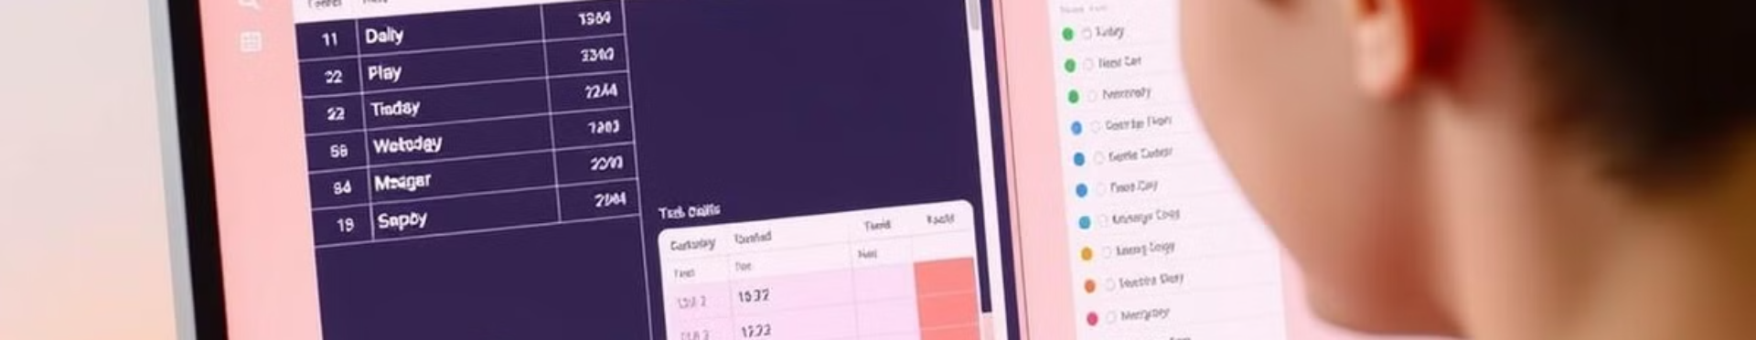
A Dual-Table Solution
Table 1: Daily Summary
Table 2: Task Details
This table captures daily metrics including attendance status, work hours, task counts, and overall outcomes.
This table provides granular details on individual tasks, including descriptions, planned and actual work time, and status updates.

Slide 4
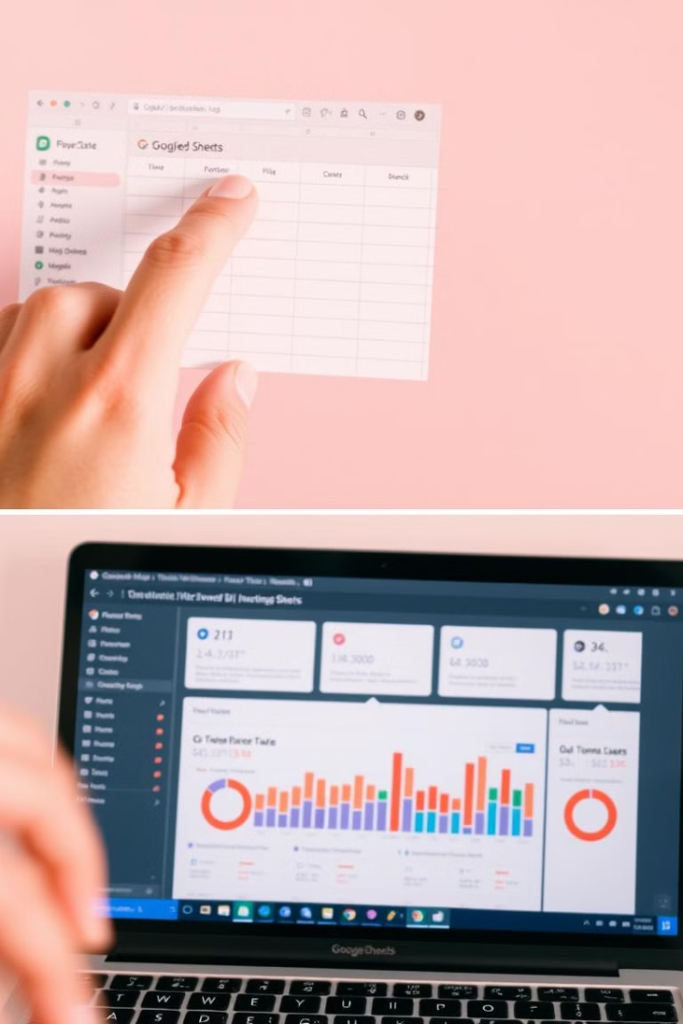


Implementation and Integration
Data Collection
Dashboard Creation
Separate Google Sheets were created for each employee, enabling them to easily log their daily activities and track their work.
Power BI was connected to the Google Sheets to provide real-time data visualization and analytics, offering management actionable insights.

Slide 5



The Outcome: Streamlined Management
1
Simplified Data Entry
2
Improved Data Accuracy
3
Actionable Insights

